Slide 1



BREAST CANCER DETECTION

Slide 2

CONTENT
01
UNDERSTANDING BREAST CANCER
02
ROLE OF MACHINE LEARNING IN MEDICAL DIAGNOSIS
03
PROBLEM STATEMENT
04
ADABOOST ALGORITHM FOR EARLY DETECTION
05
DATASET
06
IMPLEMENTATION

Slide 3

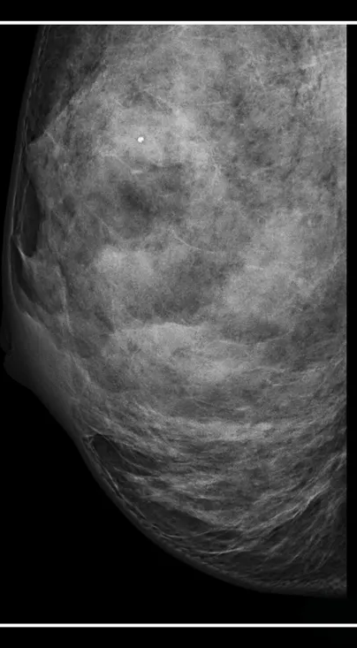

UNDERSTANDING BREAST CANCER
Breast cancer is a common type of cancer that develops in the cells of the breast. It primarily affects women, but men can also develop it.
Symptoms:
lumps
nipple discharge
skin changes.
Risk factors include age, family history, genetics, and lifestyle choices.

Slide 4
TYPES OF BREAST CANCER
Malignant: Malignant breast cancer is a type of breast cancer that is cancerous and has the potential to spread to other parts of the body. It is the most common type of breast cancer.
Benign: Benign tumors are usually well-defined and round or oval in shape. Malignant tumors are usually poorly defined and irregular with lobules.

Slide 5

IMPORTANCE OF EARLY DETECTION
Increased Survival Rates
More Treatment Options
Reduced Severity of Treatment
Lower Costs

Slide 6

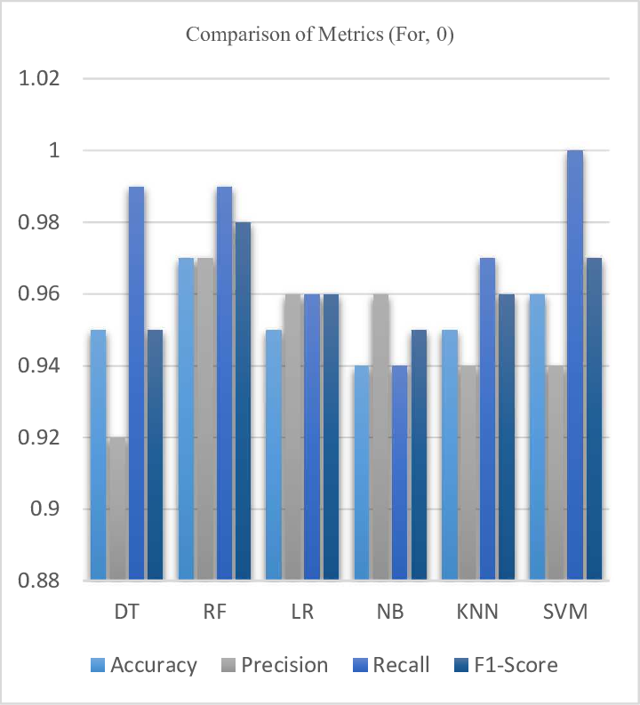
ROLE OF MACHINE LEARNING IN MEDICAL DIAGNOSIS
High Accuracy of Early Detection Models:
Show a bar chart comparing the accuracy rates of various ML models in detecting early-stage breast cancer vs. late-stage.
Example stats: ML models like SVM and Neural Networks can achieve over 90% accuracy in early-stage detection.

Slide 7
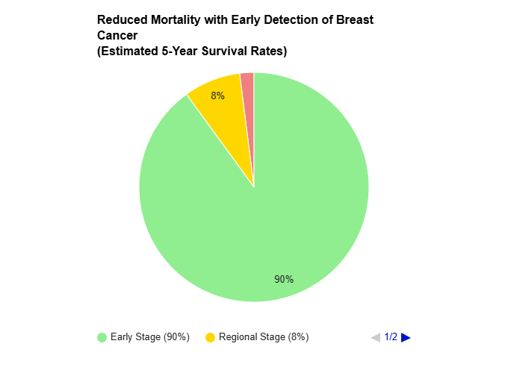
ROLE OF MACHINE LEARNING IN MEDICAL DIAGNOSIS
Reduced Mortality with Early Detection:
Pie chart showing statistics, e.g., "Patients diagnosed at an early stage have a 90% 5-year survival rate compared to only 8% for regional-stage diagnosis and 2% for Distant stage”

Slide 8

PROBLEM STATEMENT
Objective:
This project focuses on using the AdaBoost classifier to detect breast cancer. It aims to teach students about applying machine learning in medical diagnosis by implementing and training the AdaBoost model on breast cancer data.
Why It Matters:
Early detection is vital for improving treatment outcomes. This project aims to develop a model that assists in recognizing cancerous patterns quickly and accurately.

Slide 9


ADABOOST ALGORITHM FOR EARLY DETECTION
AdaBoost, an ensemble learning algorithm, is a powerful tool for early breast cancer detection. By combining multiple weak classifiers and adaptively weighting misclassified samples, AdaBoost can effectively learn from complex patterns in medical image data.
It's robust to noise and outliers, making it suitable for real-world applications. Additionally, AdaBoost can help identify the most important features, leading to more efficient and accurate models. By leveraging these strengths, AdaBoost can contribute to improved early detection and better patient outcomes in breast cancer.

Slide 10

ALGORITHMS FOR EARLY DETECTION
Support Vector Machines (SVM)
Decision Trees
Neural Networks
K-Nearest Neighbours

Slide 11
DATASET
Dataset Overview:
Source: UCI Machine Learning Repository.
Purpose: Commonly used for breast cancer diagnosis research.
Dataset Features:
Contains features extracted from breast cell images, which are crucial for cancer detection.
Includes both malignant and benign samples for training the model effectively.

Slide 12

IMPLEMENTATION
IMPORT
DATA PREPROCESSING
TRAIN
TEST
Import the Dataset.
Check the information and gain the insights of the dataset
Train the data according to the model designed
Test the data and check the accuracy, error and other metric info
Key steps in data preparation include handling missing values, feature scaling, and data splitting into training and testing sets. These preprocessing steps ensure the model learns from clean, structured data, leading to improved accuracy in predictions.

Slide 13

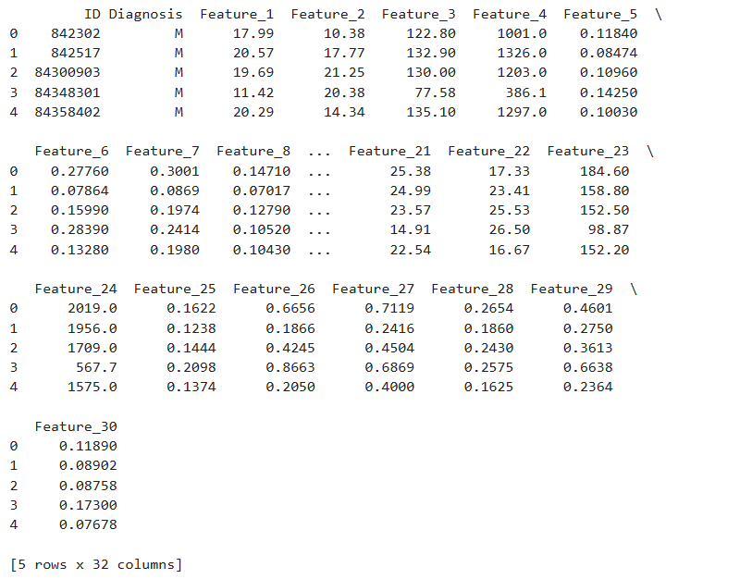
IMPORT
Preprocessing:
Importing Required dataset
Pandas: Data manipulation and analysis.
Seaborn: Statistical data visualization.
Matplotlib: General-purpose plotting library.
NumPy: Numerical operations on arrays.
Scikit-learn: Machine learning algorithms.
1st few rows of data

Slide 14

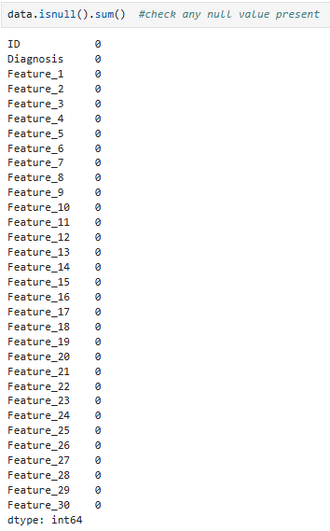

PREPROCESSING
Shape of the dataset
the dataset has 569 rows of patient records, each described by 38 columns of features.
Checking any null value present
there are no null values
Checking any duplicate value present
there are no duplicate values

Slide 15
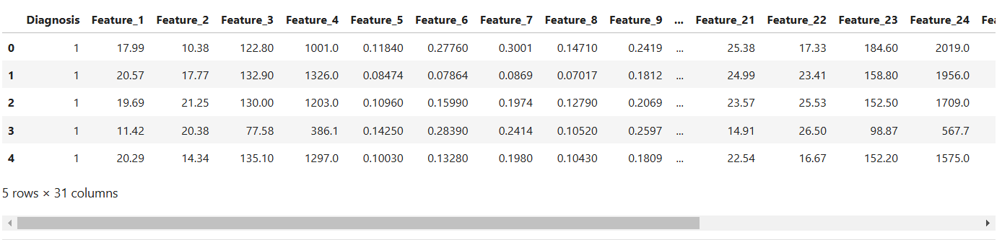
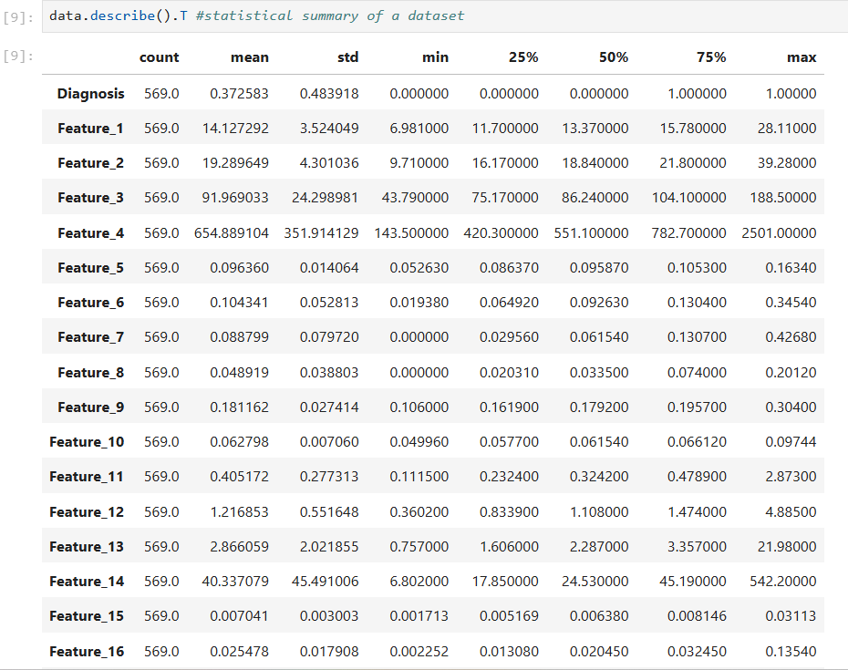
PREPROCESSING
converting categorical values in the 'Diagnosis' column of a dataset into numerical values
Mapping
Malignant = 1
Benign = 0
statistical summary of the dataset,

Slide 16
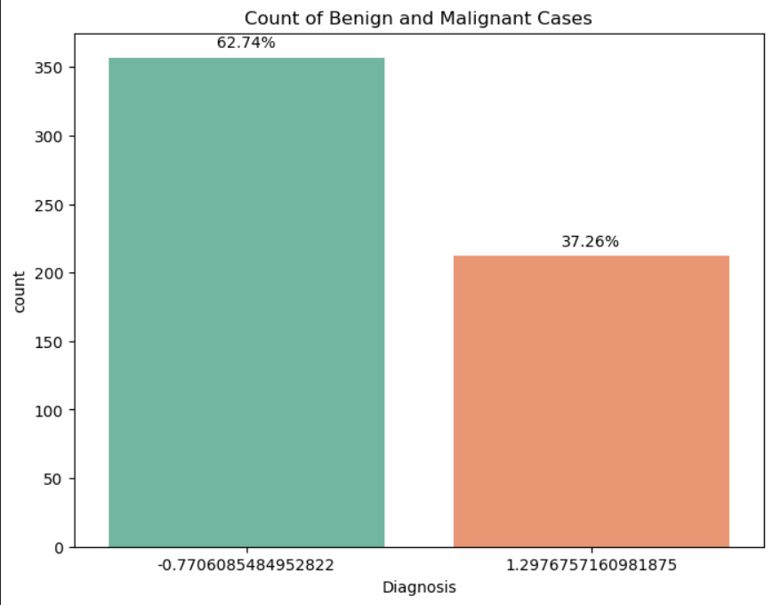
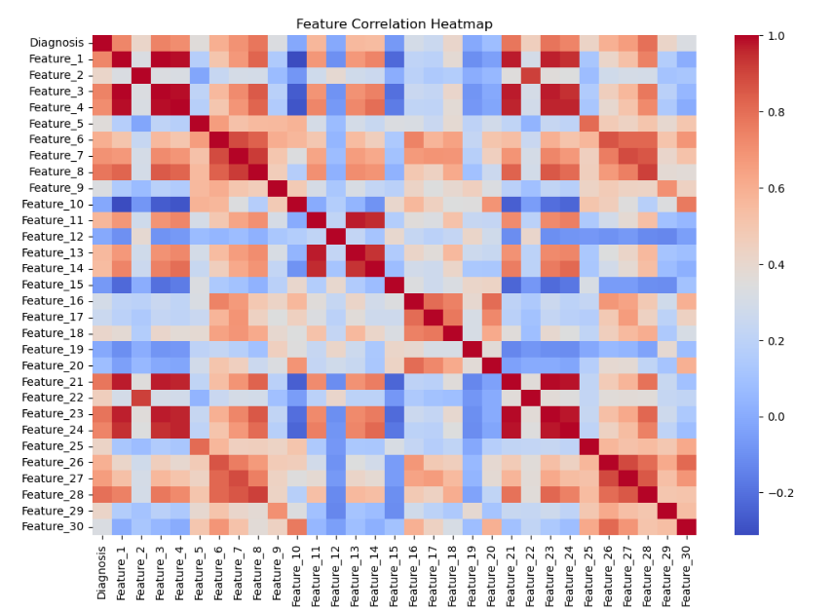
VISUALIZATION
creates and displays a count plot using Seaborn to visualize the distribution of the target variable "Diagnosis" in DataFrame, showing the counts of majority of "Benign" over "Malignant" cases. Approximately 62.74% of the cases are benign, while 37.26% are malignant.
generates and displays a correlation heatmap using Seaborn,The diagonal line from the top-left to the bottom-right represents the correlation of each feature with itself, which is always 1.

Slide 17
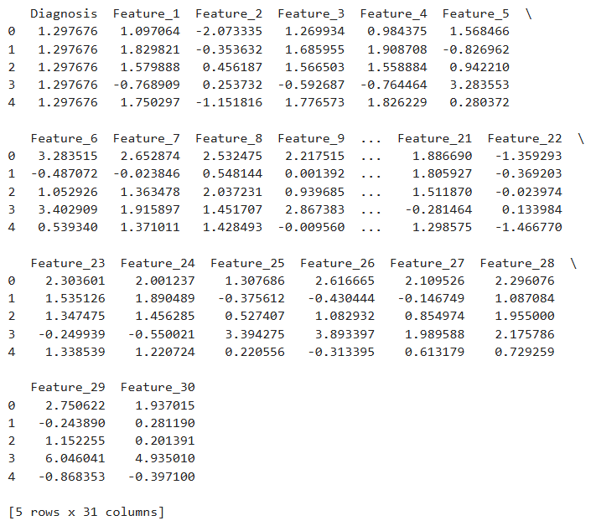
SCALING
Z-score scaling
standardizes all numerical features in the data DataFrame to have a mean of 0 and a standard deviation of 1 using Z-score scaling.Z-score scaling is less sensitive to outliers, making it a good choice for datasets with outliers

Slide 18
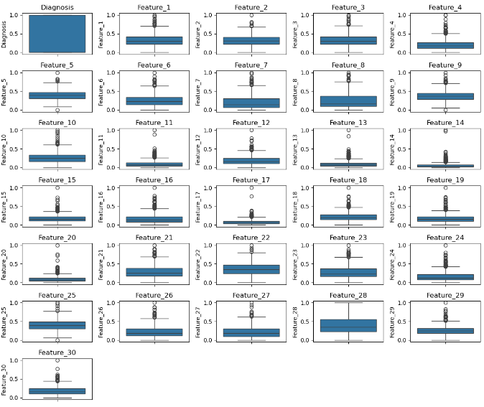
OUTLIERS
Checking outliers using IQR Method
number of outliers present in each feature,outlier needs further investigation to check valid or invalid
checking outliers using BoxPlots

Slide 19

SPLITTING OF DATA
Splitting the data for training and testing
we have split the data in ratio 70:30

Slide 20

OUR TEAM
V Sharmila
Priyadharshini R
Everest Cantu
Ceo Of Ingoude Company

Slide 21

THANK YOU

